Slide 1

Exploratory analysis
Center for Health Data Science

Slide 2
OVERVIEW
Count matrix and normalization
RPKM/FPKM-TPM-DESeq2
Exploratory Analysis
PCA, Pearson correlation,
distance heatmaps
Workflow
Differential Expression Analysis
Comparison between
conditions
Functional Analysis
Gene-gene correlation
Networks
GO term

Slide 3
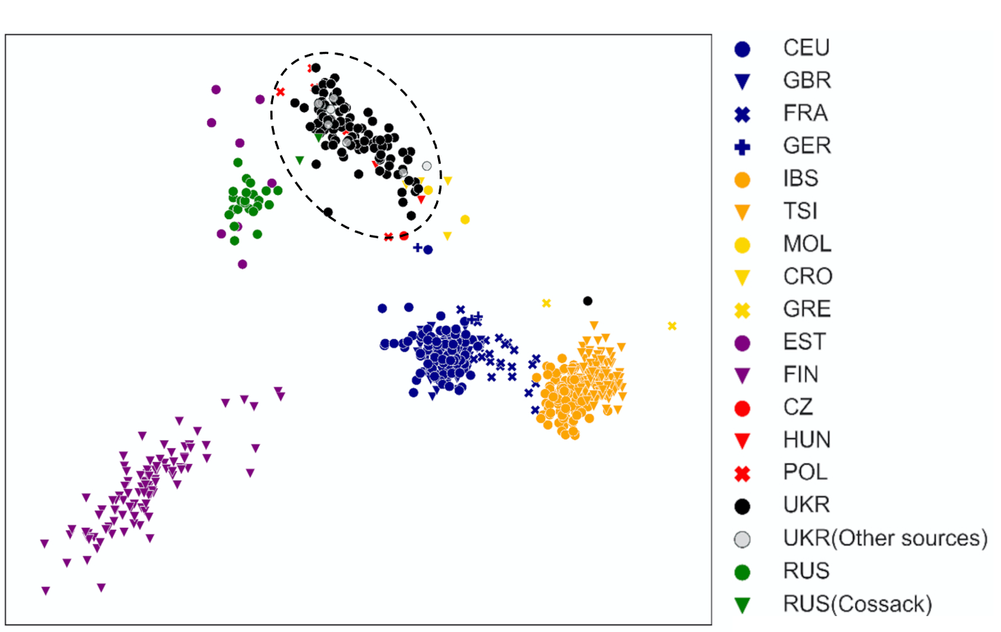
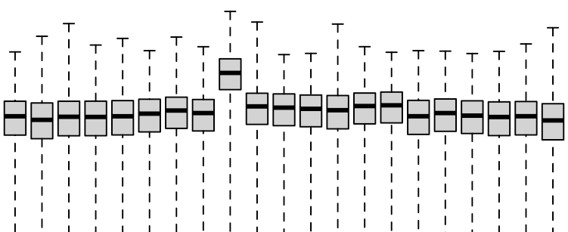
Exploratory Analysis
Does the ‘relationship’ between samples fit our expectation?
Sources of variation in the dataset?
Variance of interest
Confounding variances
Technical
We explore sample similarity with dimensionality reduction (PCA, MDS, t-SNE, UMAP) and clustering.
Sample-level count distributions and variances can help identify outliers.
PC2
PC1

Slide 4
Exploratory Analysis - Data transformation
Distribution of RNAseq count data:
Model with a Poisson distribution (PD)?
PD assumes mean == variance, count distributions are overdispersed! Negative binomial distribution
Genes with extreme counts may effect the sample relationship in low dimensional space
We could perform a log-transformation

Slide 5
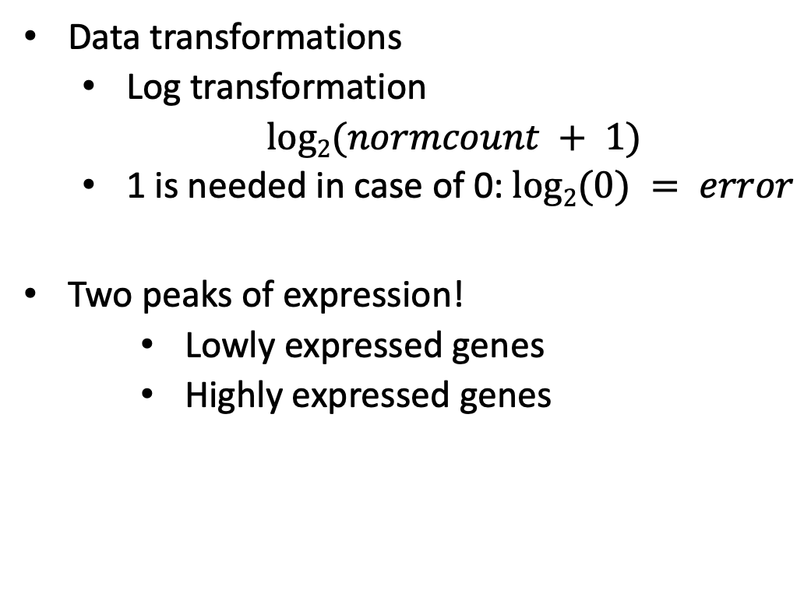
Data Tranformation – log2
Data transformations
Log transformation
$log2(normcount + 1)$
1 is needed in case of 0: $log2(0) = error$
Two peaks of expression!
Lowly expressed genes
Highly expressed genes
log2(norm counts +1)

Slide 6
Data Tranformation – rlog & vst
log2(count + n) n is estimated by regularized logarithm (rlog) or variance stabilizing transformation (vst)
log2 transformation taking into account library size - avoid high variance of the log count when the mean is low
Log2(count + 1)
VST
Standard Deviation
Standard Deviation
rank(mean)
rank(mean)

Slide 7
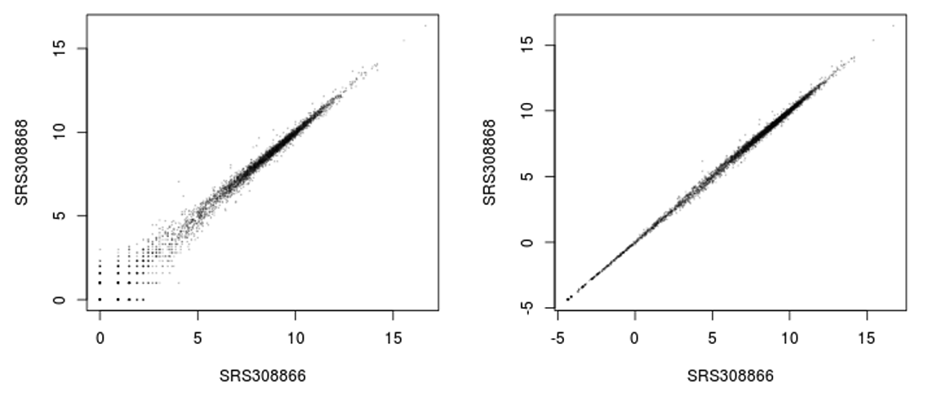
Exploratory Analysis - Rlog or VST
Log2 transformation vs Regularized logarithm (rlog)
Log2 transformation
Rlog transformation

Slide 8


Let’s Do Some Exploratory Analysis

Slide 9
Exploratory Analysis - Visualization
Now, we can compare our samples with a PCA or heatmaps
rlog and vst should not be used for Differential Expression Analysis (DEA)
Principal Component Analysis (PCA)
Principal Sample distances
rlog transformation

Slide 10
Exploratory Analysis - PCA
Principal Component Analysis
Visualize variation dataset of high dimensionality
Samples are observations (o), genes are dimensions (d)
We can only interpret 2 or 3 dimensions
y
gene | Norm sampleA | Norm sampleB | o = 100
EF2A | 1145.39 | 1176.62 | …
ACBD1 | 16.92 | 16.88 | …
d = 20000 | … | … | …
x
z

Slide 11
Exploratory Analysis - PCA
Variation of genes is collapsed into Principal Components (PCs)
PC1
1st maximum variance
Little variation
geneB
geneA Expression
PC1
Highly variable
PC2
2nd maximum variance
PC2
geneB Expression
geneA

Slide 12
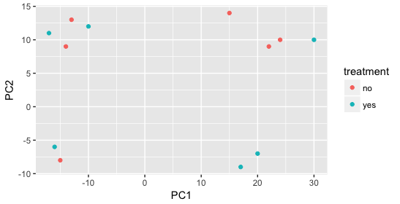
Exploratory Analysis - PCA
Variation of genes is collapsed into Principal Components (PCs)
Samples with similar gene expression related to PCs will be together
First PCs contain most variation
Usually PC1-PC4 are used
We need metadata to understand
source of variation

Slide 13
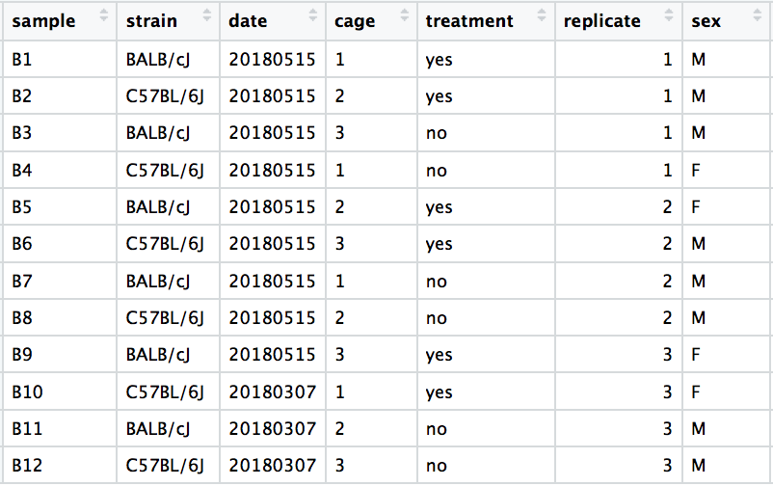
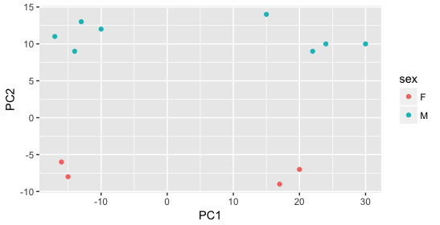
Exploratory Analysis - PCA
We need meta-data to understand

Slide 14
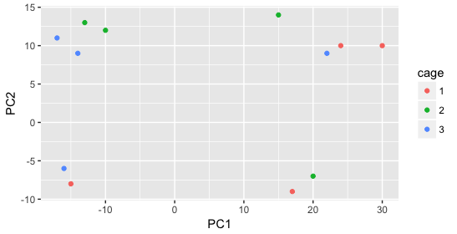
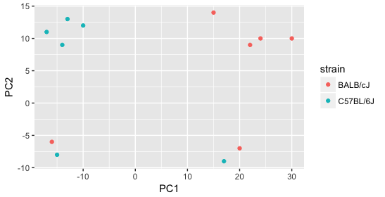
Exploratory Analysis - PCA
We need meta-data to understand

Slide 15
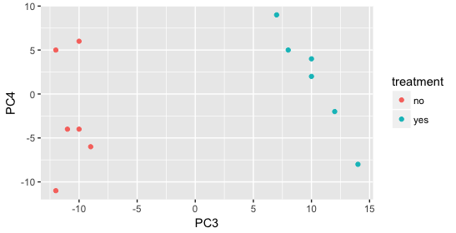
Exploratory Analysis - PCA
We need meta-data to understand

Slide 16
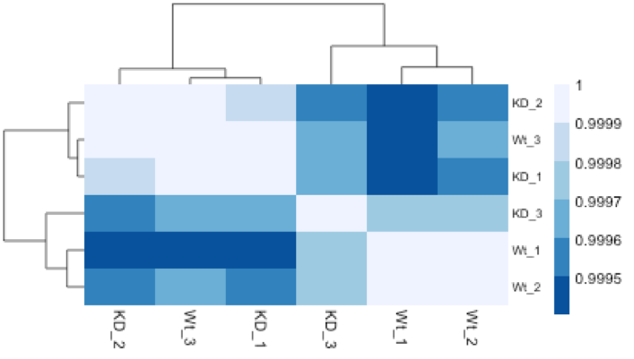
Exploratory analysis. Heatmaps
Hierarchical clustering and heatmaps
Cluster/group samples together
Can use:
Gene expression distances
Correlations
Heatmap and dendrogram
Complements the PCA

Slide 17
Exploratory Analysis - Visualization
An example of when something is not quite right…

